Slide 1
Q&A session #1 Introduction
Mathieu Boudes (European Patients’ Forum)

Slide 2
Brought to you by

Slide 3
to make patient engagement in medicines development easier for all

Slide 4
Multi-stakeholder collaboration funded by the Innovative Medicines Initiative 33 months – ending Nov 2020
4

Slide 5
3 phases
Data gathering
Creation
Communication
Dissemination
Publication
33 months
Apr 2018
Nov 2020
Survey
Focus groups
Gap analysis
today
Priotisation

Slide 6
PARADIGM Patient Engagement Toolbox
Planning Patient Engagement | Conducting Patient Engagement | Reporting and Evaluation
Recommendations on the required capabilities for patient engagement | Code of Conduct for all stakeholders involved in patient engagement activities within medicines development | Guidance for Reporting and dissemination of patient engagement activities
Raising awareness on managing competing interests in a multi-stakeholder environment: Guidance to patients and engaging stakeholders | Working with Community Advisory Boards: Guidance and tools for patient communities and pharmaceutical companies | Patient engagement monitoring and evaluation framework
Enhancement of EUPATI industry guidance Events and hospitality Suggested working practices | Patient engagement in Early dialogue: Tools and resources for HTA bodies
Patient Engagement agreements explained
Recommendations on how to find the right match for the right patient engagement activity
https://imi-paradigm.eu/petoolbox/

Slide 7
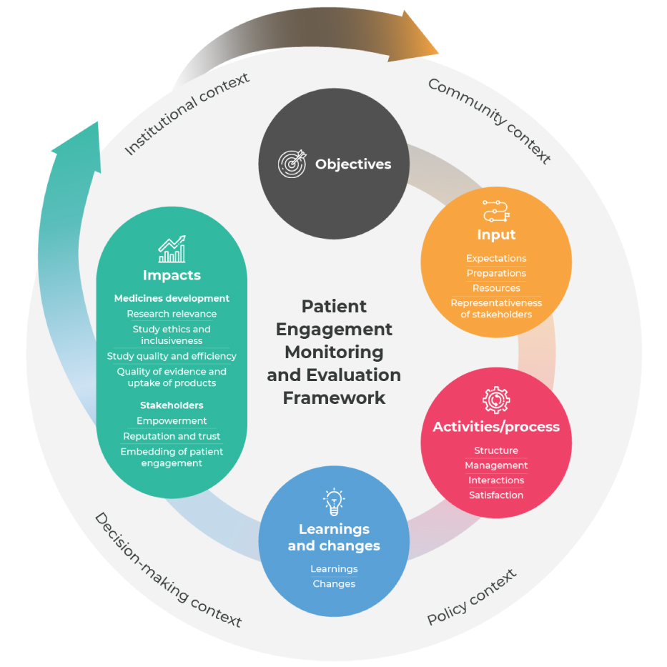
Patient Engagement Monitoring and Evaluation Framework, with metrics
The PE Monitoring and Evaluation Framework, with metrics, was created to help stakeholders involved in the medicines development lifecycle to self-evaluate the progress and impact
Content The tool provides a map for monitoring and evaluation of patient engagement across multiple decision-points in medicines R&D, including 87 metrics organized across four key evaluation components: 1. Input metrics (n=13)
2. Activities/process metrics (n=16)
3. Learning and change metrics (n=13
4. Impact metrics (n=45)
The context component allows users to understand what contextual factors may facilitate or inhibit success.
Each metric is accompanied by a description and possible methods for monitoring and evaluating its progress.
Notes:
1- Input metrics (n=13) show whether or not the conditions for meaningful and sustainable patient engagement are in place. 2. Activities/process metrics (n=16) show how the implementation of patient engagement is progressing and can elucidate areas for improvement. 3. Learning and change metrics (n=13) show the short-term, direct results of patient engagement which give an indication of the progress made towards impacts. 4. Impact metrics (n=45) show the long-term impacts for medicines development and stakeholders.

Slide 9
What is the Patient Engagement Open Forum
A series of virtual events (in 2020) where we will work together, in a multi-stakeholder context, to turn patient engagement into reality.
The Forum aims to provide a holistic perspective of patient engagement, the landscape and actors, and foster collaboration and co-creation while breaking down fragmentation that are often present in patient engagement work.

Slide 10
Q&A session #1 Raising awareness on managing competing interests in a multi-stakeholder environment: Guidance to patients and engaging stakeholders
Maria Cavaller (EURORDIS-Rare Diseases Europe)

Slide 11
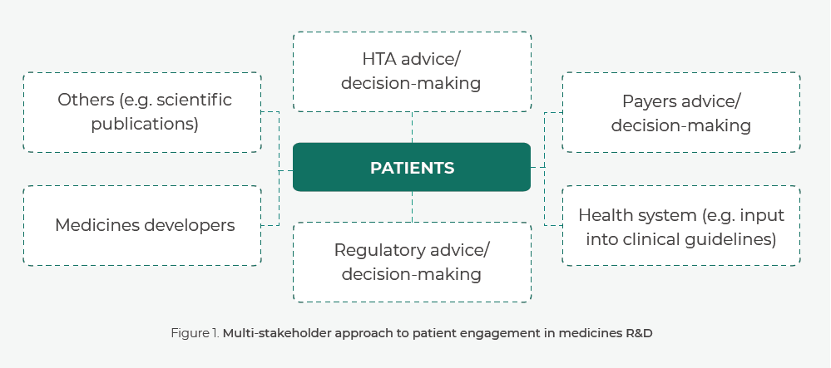
Why is it important to check potential competing interests?
Previous interactions with any stakeholder involved in medicines R&D might affect the ability to engage in a given activity
Early identification of potential competing interests is key for their effective management

Slide 12
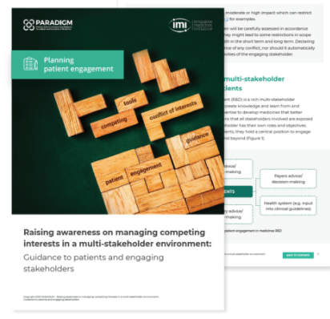
Objectives
Raising awareness among patients and the engaging stakeholder organisations of the consequences that the act of engagement might have on patients during multi-stakeholder interactions
Highlighting how each stakeholder could better prospectively manage competing interests, and
Avoiding/minimising conflict of interest by suggesting risk mitigation strategies

Slide 13
Raising awareness on managing competing interests in a multi-stakeholder environment: Guidance to patients and engaging stakeholders
Short guidance on managing competing interests and conflicts of interests
Log of patient engagement activities
Educational scenarios on competing interests and conflicts of interest

Slide 14
Example of competing interests vs conflicts of interest
Notes:
.

Slide 18
Declaration of interests
?
For example, you will be asked to provide information such as:
Your affiliations/employment as far as 3 years back from the time of filling the form
All current and/or past financial interests
Involvement as an advisor to or a member of an advisory board and/or steering committee for a pharmaceutical company, CRO or another organisation (including non-profit organisations)

Slide 19
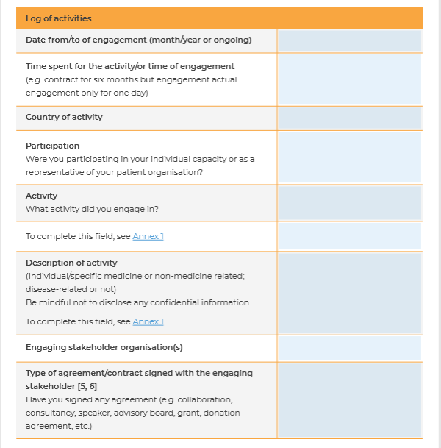
Log of activities template
This tool has been developed for patients and their organisations
You will be able to accurately track and declare your interests as required before getting involved in activities along the medicines’ life-cycle
You can use this tool as a guidance to set up your own log of activities, or that of your organisation

Slide 20
Take home messages
Keep accurate and transparent records of your interactions with different stakeholders, by using the log of activites, for example, and disclose the interactions before any engagement. If you engage with a given stakeholder, prepare your own Dol form and update it periodically.
Make sure that engagement and advocacy activities at your organisation are done by different individuals (diversification) to ensure that there will be always someone free from conflict to engage with other stakeholders.
Be aware and make use of any accepted mitigation measures in situations that might lead to Col (Educational scenarios & Main Guidance)
Ask about the potential consequences of the particular engagement activity to the engaging stakeholder.

Slide 21
Now…your turn!
Q&A

Slide 22
PARADIGM Patient Engagement Tools 25th June Session #1 https://patientengagementopenforum.org/ https://www.youtube.com/watch?v=JFzsR6i0m3s&feature=youtu.be

Slide 23
Agenda

Slide 24
Upcoming Q&A sessions
9th November (3 - 4 pm CET)
Recommendations on required capabilities for patient engagement
Patient engagement in medicines development: Recommendations on how to find the right match for the right patient engagement activity
16th November (3 -4 pm CET)
Patient Engagement Monitoring and Evaluation Framework
20th November (3 -4 pm CET)
Working with Community Advisory Boards: Guidance and tools for patient communities and pharmaceutical companies
Guidance for reporting and dissemination of patient engagement activities
Save the date and register here: https://www.surveymonkey.com/r/KD7KZTW

Slide 25
Thank you!
maria.cavaller@eurordis.org

