Slide 1
Q&A session #2 Recommendations on required capabilities for patient engagement & Recommendations on how to find the right match for the right patient engagement activity
Virginie Hivert (EURORDIS-Rare Diseases Europe)
Mathieu Boudes (EPF-European Patients Forum)

Slide 2
Recommendations on required capabilities for patient engagement

Slide 3
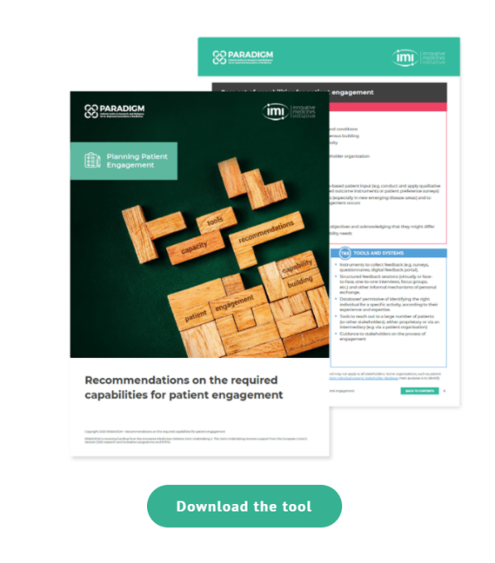
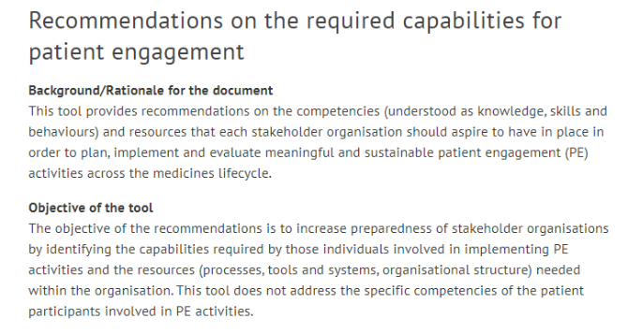
For all stakeholders
Relevant stakeholder organisations include those involved in the development of medicines, including industry and patient organisations, academia, regulatory authorities, HTA bodies and payers.

Slide 4
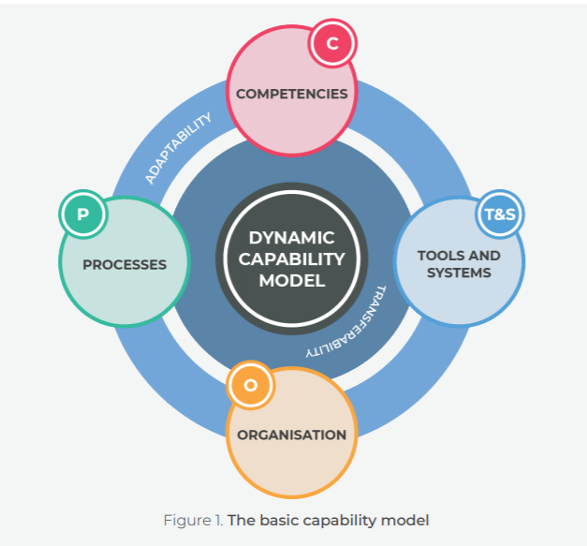
Basic capability model for patient engagement
Competencies: Combination of knowledge, skills and behaviours of an individual
Processes: Define how things can be done. They can change in accordance with internal policies, regulations, technologies and other influences.
Tools and systems: Instruments necessary to perform a specific task, from technological tools to the ability to use certain systems.
Organisation: Refers to the organisational structure (functions) of each stakeholder group and also to an organisational culture that enables ethical and meaningful engagement.
Adaptability and transferability: reflect the reality of the current PE ecosystem in terms of constant adaptation and refinement (of processes and practices) and the needs of learning exchanges both within and across stakeholder organisations.

Slide 5
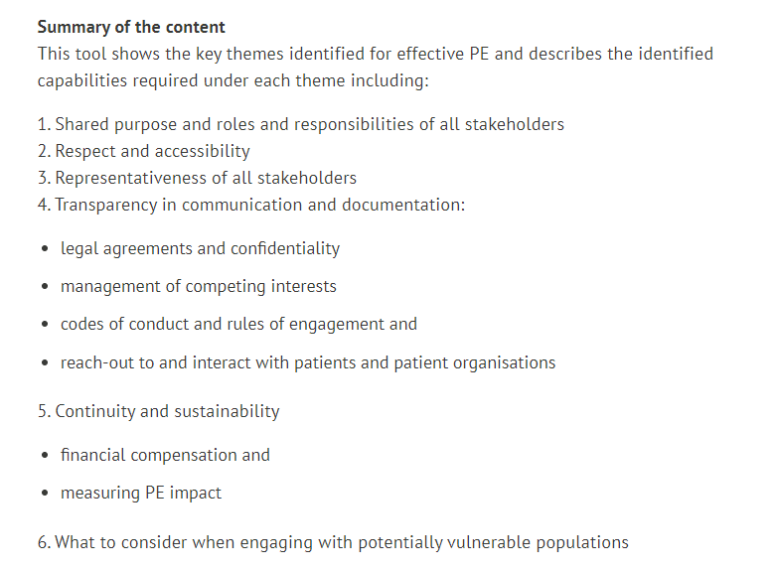
Table of Content
Alignement with Patient-Focused Development (PFMD) Patient Engagement Quality Guidance[6], used as an underlying framework to divide, where appropriate, the present document into sections that would cover the most relevant aspects of PE in medicines development.
Download all at once
or
one single factsheet at a time

Slide 6
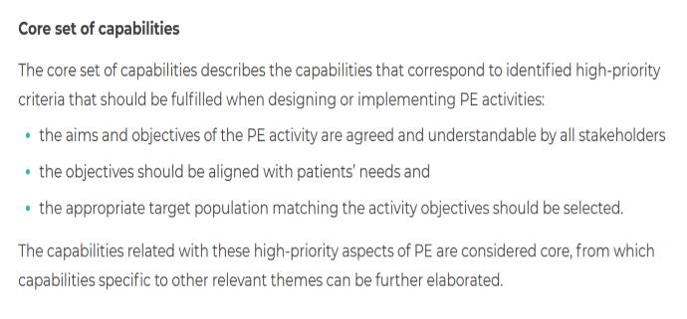
Core set of capabilities

Slide 7
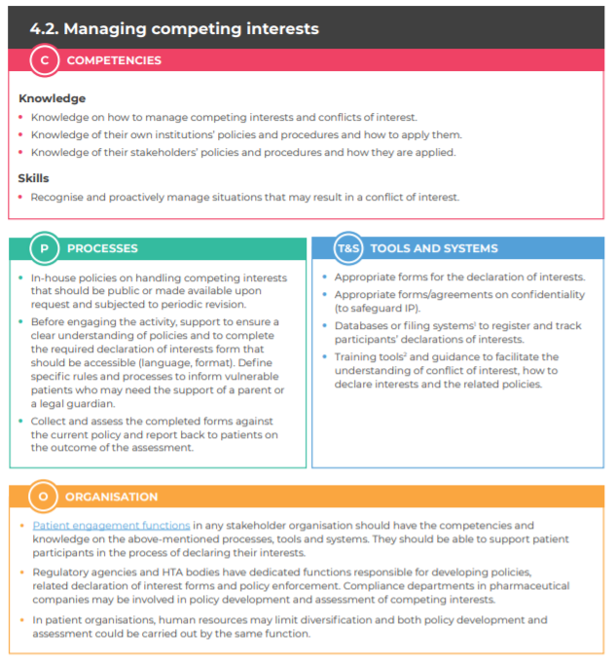

Slide 8
Patient engagement functions
Single point of contact both internally and externally hence initiating, facilitating and overseeing the engagement process
Identify the right patients for the PE activity
Operationalise and manage PE throughout the process from start-to-finish
Handle requests for collaboration that can cover a very wide range of activities
Ensure maintenance of the quality of the PE process among the different functions involved (e.g. Clinical research team)
Establish and/or implement the defined framework for PE
Be accountable towards the processes
Act as reference/ expert in patient engagement within their organization
Raise awareness about and foster PE
Provide support to other functions on PE
Organise training on PE for the organisational functions directly involved in PE
Patient engagement functions might be organised by types of activities in which the engagement of patients is requested (i.e. clinical trial design) or by medical areas.

Slide 9
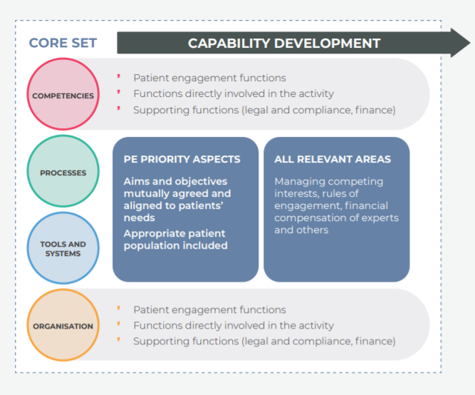
Recommendations
Equip organisations with organisational functions holding the core set to be able to effectively carry out these priority areas
This core set of capabilities should be expanded, where needed, to cover all relevant areas of PE from initially building the engagement framework to evaluating a particular activity for further improvement
Across organisations, the individual competencies should rely on the functions directly involved in the activities and more specifically will be concentrated within the functions dedicated to PE
Supporting functions will be also required to hold certain competencies in the areas of interest related to their specific function
It is for stakeholder organisations to decide whether other functions require competencies for PE based on their particular involvement, or on the organisational culture

Slide 10
Notes:
Kay

Slide 11
Case study
Notes:
Kay

Slide 12
The case
Stakeholders involved
Sheila works as head of patient engagement at Genius Pharma.
She is planning a patient engagement activity to help identify relevant rheumatoid arthritis endpoints for the design of a clinical trial
Rick is a volunteer at Arthritis Patients’ Group, an international patient organisation. He coordinates patient engagement in the organisation and provides support to patients throughout the process
Pharma company
Patient representative
The activity: Identify patient-relevant endpoints for the design of a clinical trial
Notes:
kay

Slide 13
STEP 1:
Outline the patient engagement activity on shared purpose
Notes:
kay

Slide 14
Notes:
kay

Slide 15
STEP 2A:
Identification of a relevant patient organisation to co-create the activity.
STEP 2B:
Or if no PO exists, use alternative methods (co-creation with the patient community).
Notes:
Mathieu

Slide 16
Notes:
Mathieu

Slide 17
How to find the best suitable patient organisation?
Notes:
Mathieu

Slide 18
Use the check list of the elements to consider before engaging with a patient organisation
Arthritis Patients’ Group has:
A pool of experts with experience to be involved in medicines R&D
A dedicated person to organise patient engagement activities/opportunities
A specific training programme
Well established channels to reach to the wide arthritis patient community
Notes:
Mathieu

Slide 19
STEP 3:
Sheila and Rick jointly co-define the competencies needed to carry out the activity
Notes:
Kay

Slide 20
Notes:
Kay

Slide 21
Notes:
Mathieu

Slide 22
Notes:
Mathieu

Slide 23
Notes:
Mathieu

Slide 24
STEP 4:
Rick identifies within his PO the representatives that match the needed competencies to identify patient-relevant rheumatoid arthritis endpoints
?
?
?
Experience of living with the disease
Knowledge of the R&D process and previous experience in similar activities
Rick also starts checking for competing interests before deciding who could be joining the activity
Notes:
Kay

Slide 25
Notes:
Kay

Slide 26
Now…your turn!
Q&A

Slide 27
PARADIGM Patient Engagement Tools 25th June Session #1 https://patientengagementopenforum.org/ https://www.youtube.com/watch?v=JFzsR6i0m3s&feature=youtu.be

Slide 28
Upcoming Q&A sessions
16th November (3 -4 pm CET)
Patient Engagement Monitoring and Evaluation Framework
20th November (3 -4 pm CET)
Working with Community Advisory Boards: Guidance and tools for patient communities and pharmaceutical companies
Guidance for reporting and dissemination of patient engagement activities
Save the date and register here: https://www.surveymonkey.com/r/KD7KZTW

Slide 29
Thank you!
Virginie.hivert@eurordis.org

